Slide 1
Parallelizing Burrows-Wheeler Compression
Gil Goldshlager
Term project, 6.338

Slide 2
What is Burrows-Wheeler Compression?
Three step string transform used for data compression
Block sorting transform- based on suffix arrays
Move-to-front encoding
Huffman encoding
First step can also be used to create a searchable index
Used by bzip
Better compression than gzip
But too slow!

Slide 3
How about Parallelizing it?
Group from Maryland recently (2013) developed a parallel PRAM algorithm for this
Showed significant speed-up in theory and practice, relying extensively parallel prefix
But only on their in-house parallel machine, specifically designed to quickly run PRAM algorithms with fine-grained parallelism
How easy would it be to develop these “fine-grained” parallel algorithms in Julia?
Could speedups be gained on normal machine architectures?

Slide 4
Focus: Move-to-front and Huffman Encoding
First step is the crucial performance bottleneck
Unfortunately parallelizing it is very hard
Probably isn’t possible on standard machines
And would have been too much work for a course project
Middle stages are less time intensive but more easily parallelizable
Move-to-front and Huffman encoding can also be of independent interest

Slide 5
Move-to-front Encoding and Decoding
Both involve clever interpretations of serial algorithms as parallel prefix
Details are not so exciting

Slide 6
Parallel Huffman Encoding?
Huffman Encoding
Cumsum character counts!
Count occurrences of all characters in string
Build minimal encoding table mapping character → variable size bit string
Traverse string left to right, encoding characters one at a time
AAAABCCBCCCDDAAAAAAA ----> [11,2,5,2]
A
B
C
D
1
011
00
010
Perform on master
Decode in parallel!
AAAABCCBCCCDDAAAAAAA ----> 111101100000110000000100101111111

Slide 7
Result: almost perfect parallel speedup for Huffman encoding

Slide 8
Huffman Decoding
Given the coding table, and a bit string, produce string of characters
Traverse table left to right, each time the current bitstring matches a character code, add that character to the array
That’s it!
0 | 1 | 0 | 0 | 0 | 0 | 0 | 0 | 0 | 1 | 1
 | A |  |  | B |  |  | B |  | A | C

Slide 9
Parallel Huffman Decoding? A Tad Trickier
Obvious approach: each processor decodes its local portion, run parallel prefix on the lengths of the results, and then create and write out to the output array
Problem 1: may start decoding from an invalid position
0 | 1 | 1 | 1 | 0 | 1 | 1 | 1 | 0 | 1 | 1

Slide 10
Solution 1
Local decode from every possible start point: if M is the maximal code length there are M start points
Combine results to find valid starts, slightly reapportioning array
Decode each section in parallel
0 | 1 | 1 | 1 | 0 | 1 | 1 | 1 | 0 | 1 | 1
0 | 1 | 1 | 1 | 0 | 1 | 1 | 1 | 0 | 1 | 1
 | A |  |  | B |  |  | B |  | A | C

Slide 11
Problem 2: First step does M times as much work as the serial algorithm
Solution: long internal decoding paths tend to converge. Quickly.
0 | 1 | 1 | 1 | 0 | 1 | 1 | 1 | 0 | 1 | 1
0 | 1 | 1 | 1 | 0 | 1 | 1 | 1 | 0 | 1 | 1

Slide 12
Final Local Algorithm
Split each local region into ~100 equally sized chunks
Start decoding from all M positions at the beginning of the first chunk
At the end of each chunk, collect distinct start points, and only start decoding from each one once

Slide 13
Results:
Factor of 2 loss going from serial to parallel
Near linear speedup with additional processors

Slide 14
Implementation
Used SharedArray
Would have been necessary for BST
Could have directly substituted DArray almost everywhere
Implemented fanin(), fanout() procedures analogous to star topology
Very useful! Only had to work out parallelization issues once

Slide 15
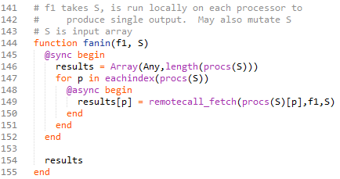
Parallelization Abstractions
Fanin:

Slide 16
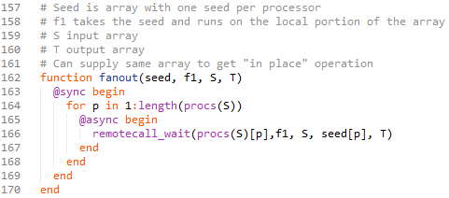
Parallelization Abstractions
Fanout:

Slide 17

Parallelization Abstractions
Star!

Slide 18
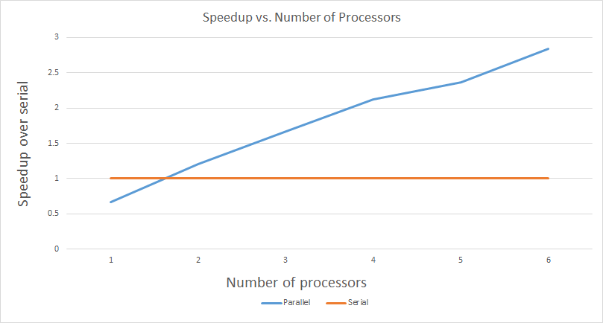
Results for all 4 steps

Slide 19
Insights
Parallel prefix is great!
But in many cases the obvious serial algorithm outperforms the parallel prefix interpretation
Run simple, possibly clever serial approach on each portion of the array
Combine the results by thinking about it as a parallel prefix
Performance pattern of parallel prefix: take a hit going from the serial algorithm to the parallel one, but then performance scales nearly perfectly with extra processors

Slide 20
Thanks for listening!
Questions?

